Slide 1
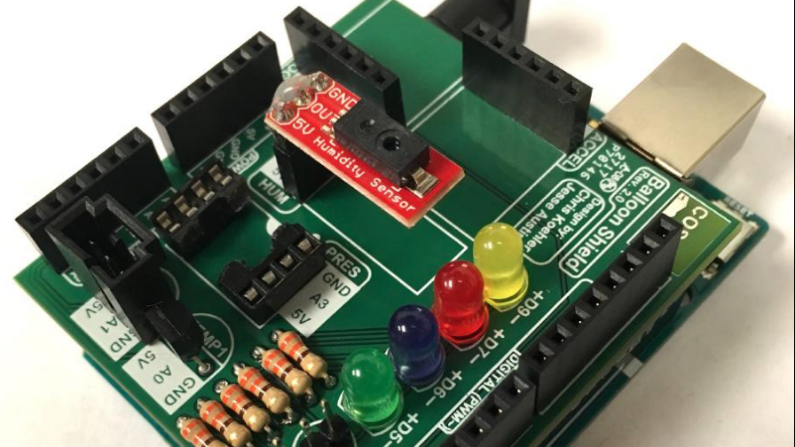
Microprocessors I Final Project
By Charlie Shields

Slide 2
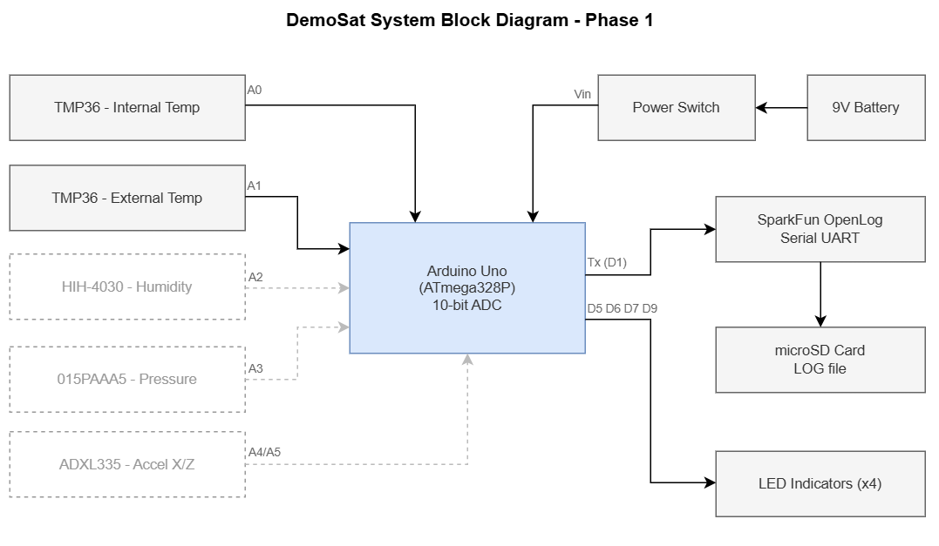
Current Design Analysis
Available:
Arduino UNO
TMP36
LEDs
Data Logger
Battery
Power Switch
Resistors
Obsolete:
Humidity Sensor
Pressure Sensor
Accelerometer

Slide 3
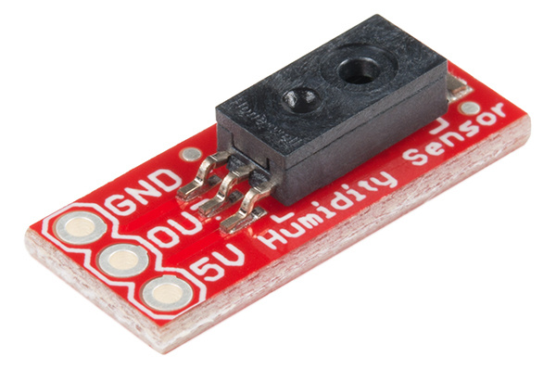
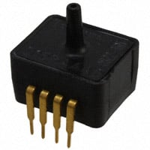
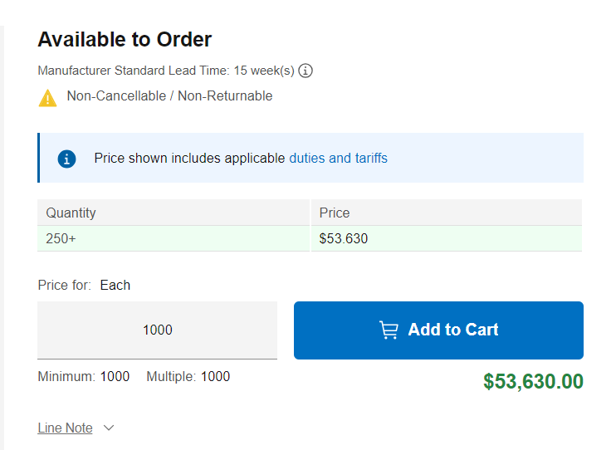
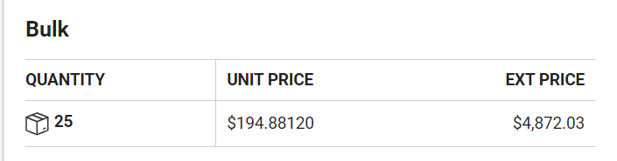

Humidity & Temperature Sensors
HIH-4030
ASDXACX015PAAA5

Slide 4
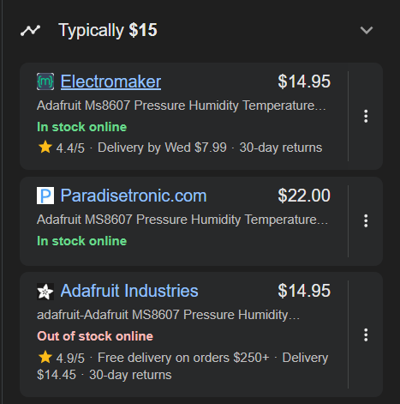
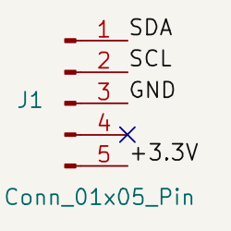
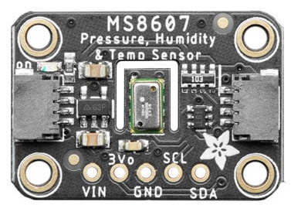

Adafruit MS8607 Breakout
Google:
Pressure
Humidity
Temperature
DigiKey:

Slide 5
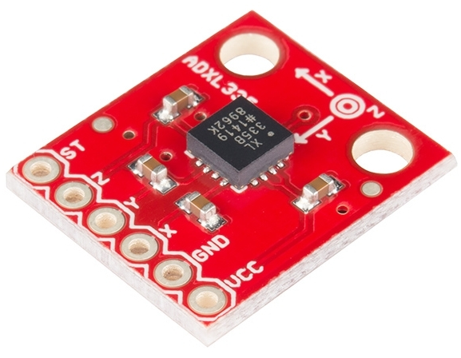
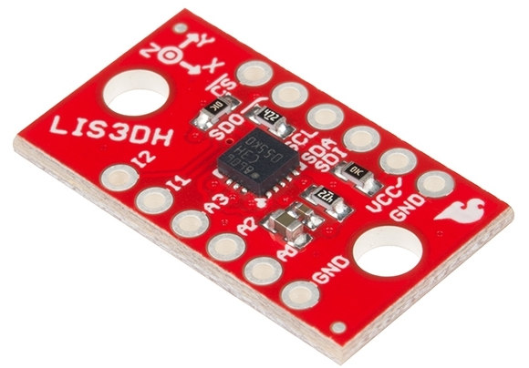
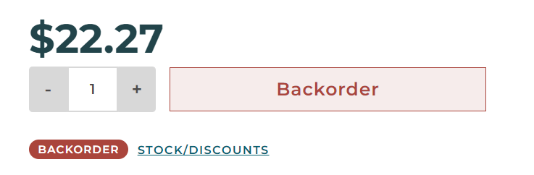

Accelerometer
SparkFun ADXL335 Breakout
SparkFun LIS3DH Breakout

Slide 6
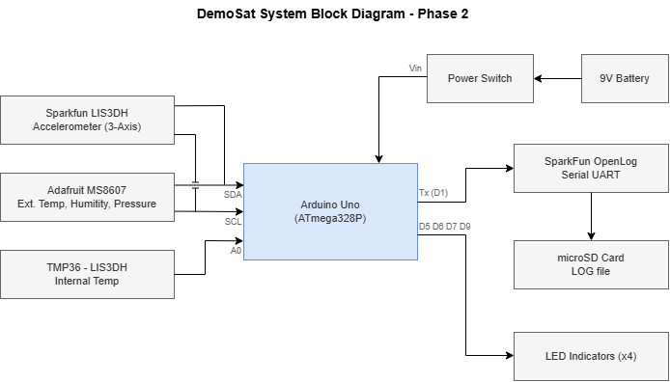

Slide 7
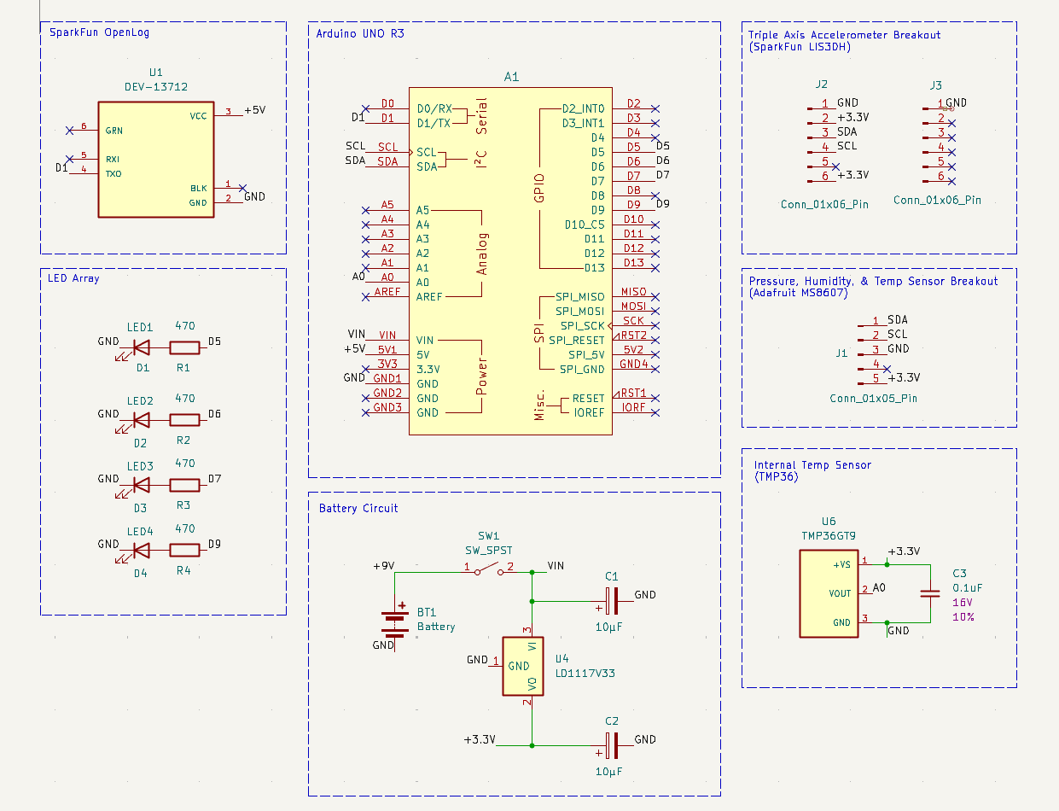
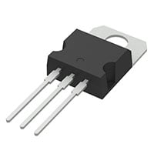
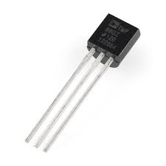
LD1117V33C
TMP36

Slide 8
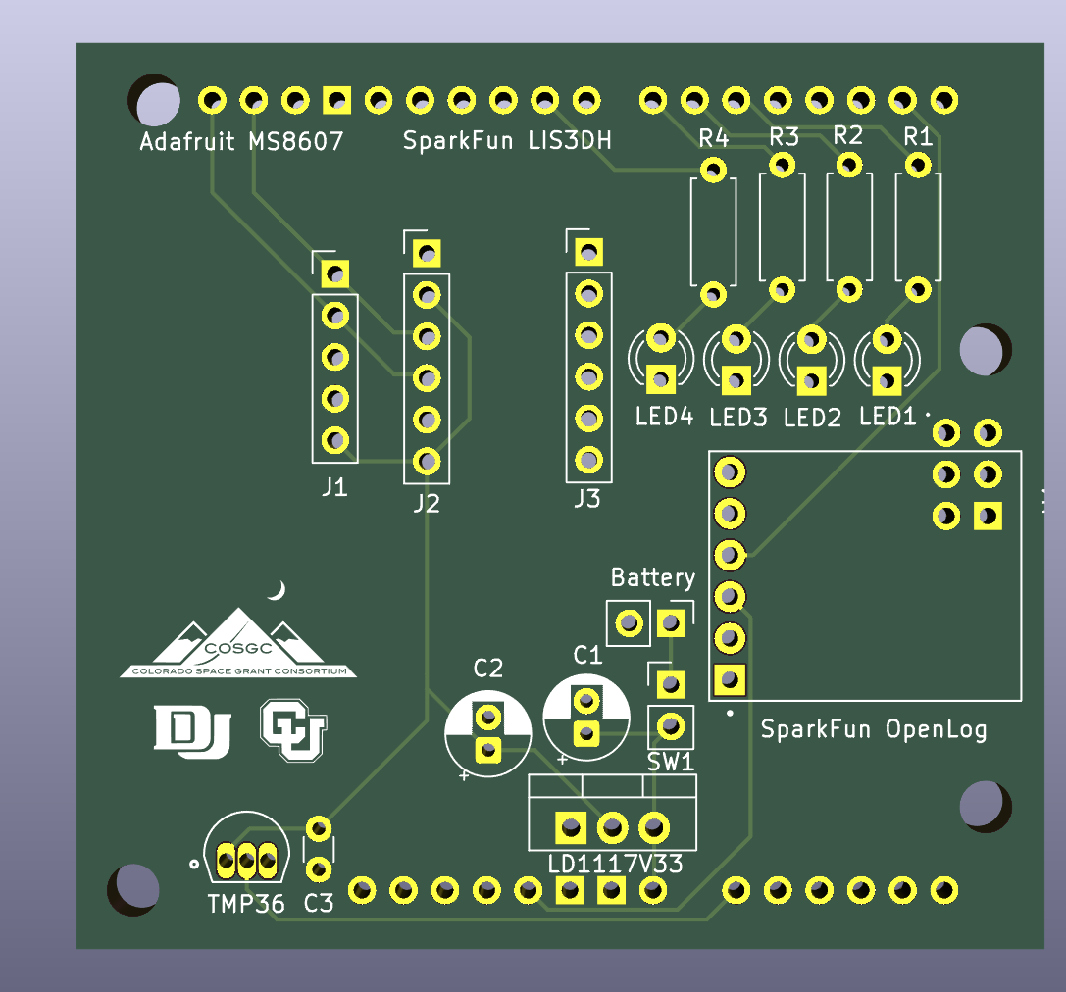
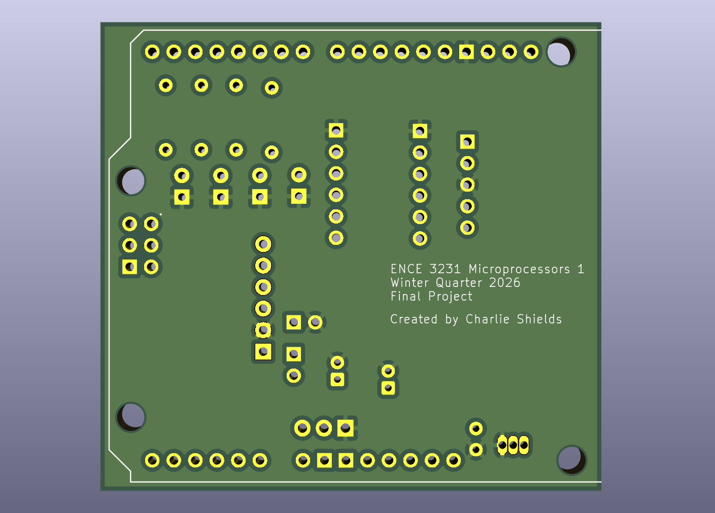
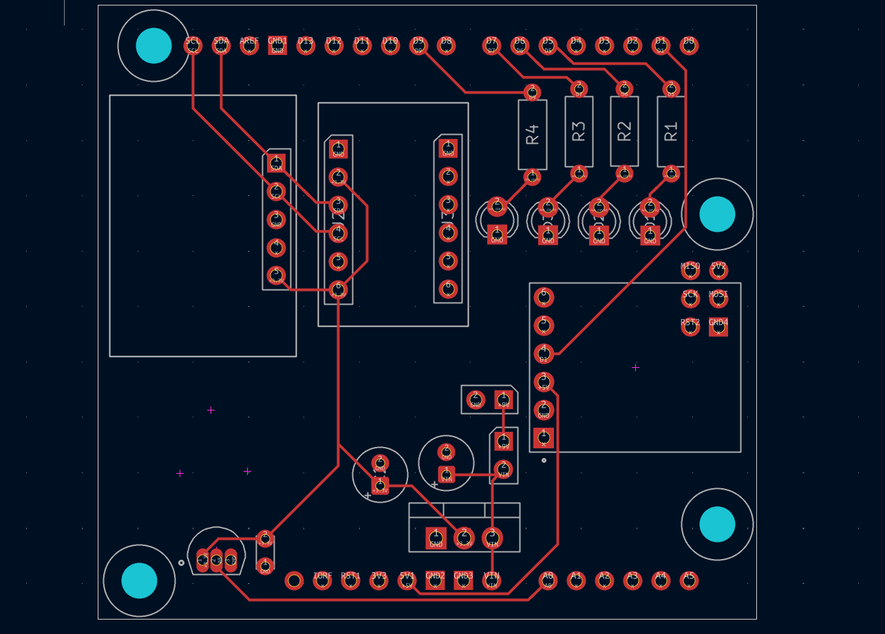

Slide 9
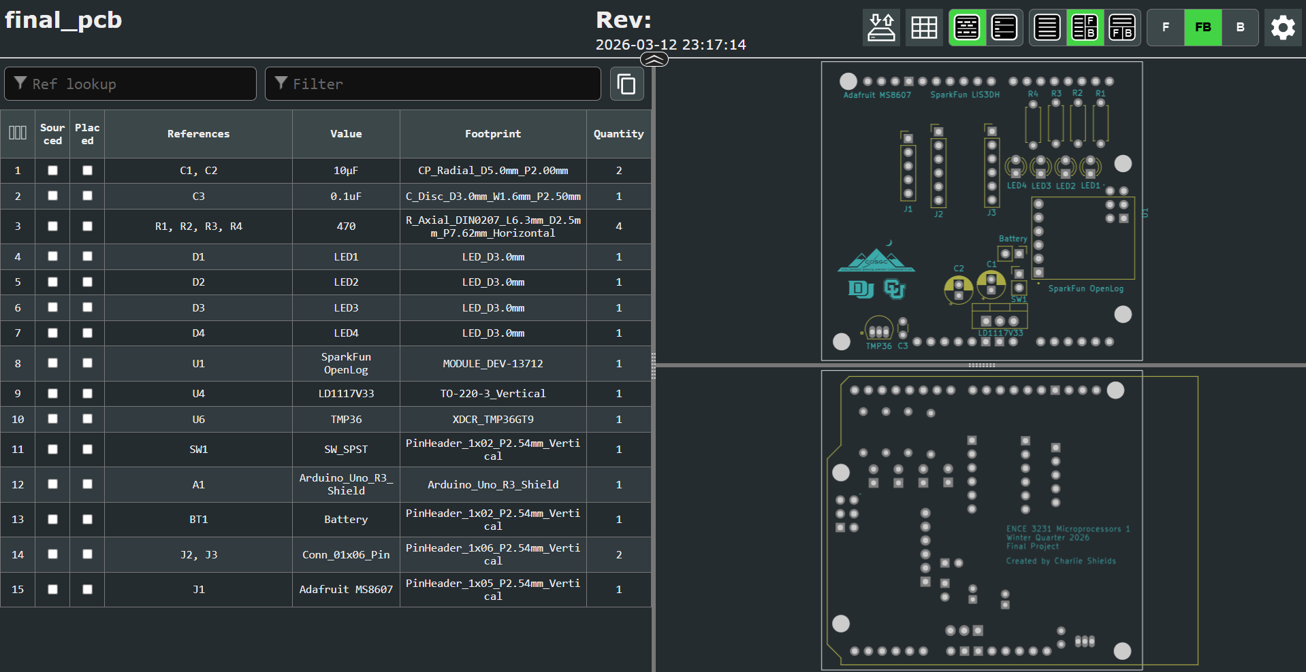

Slide 10
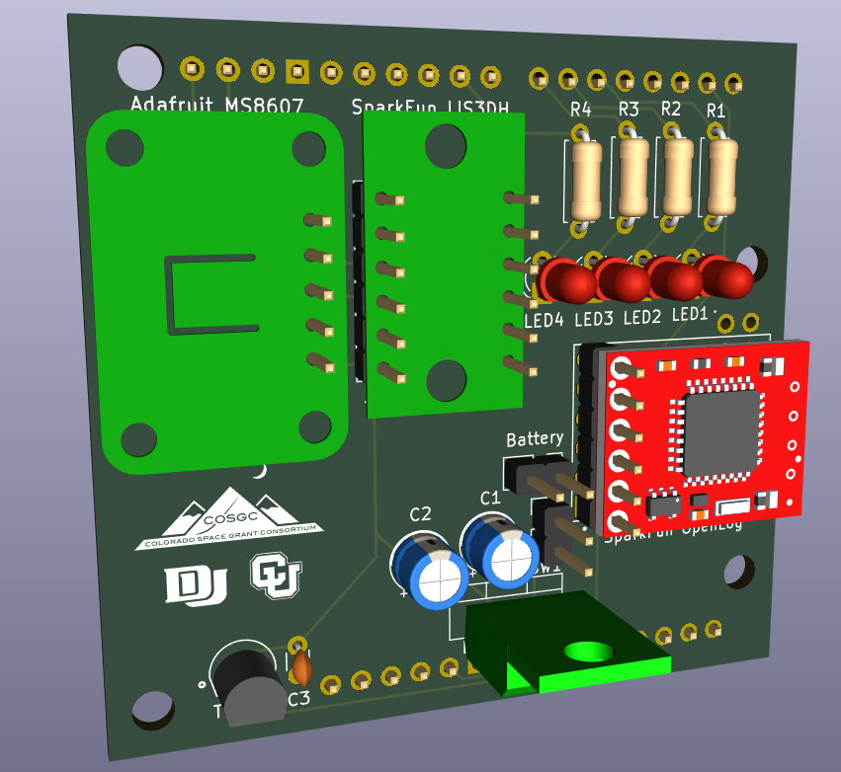
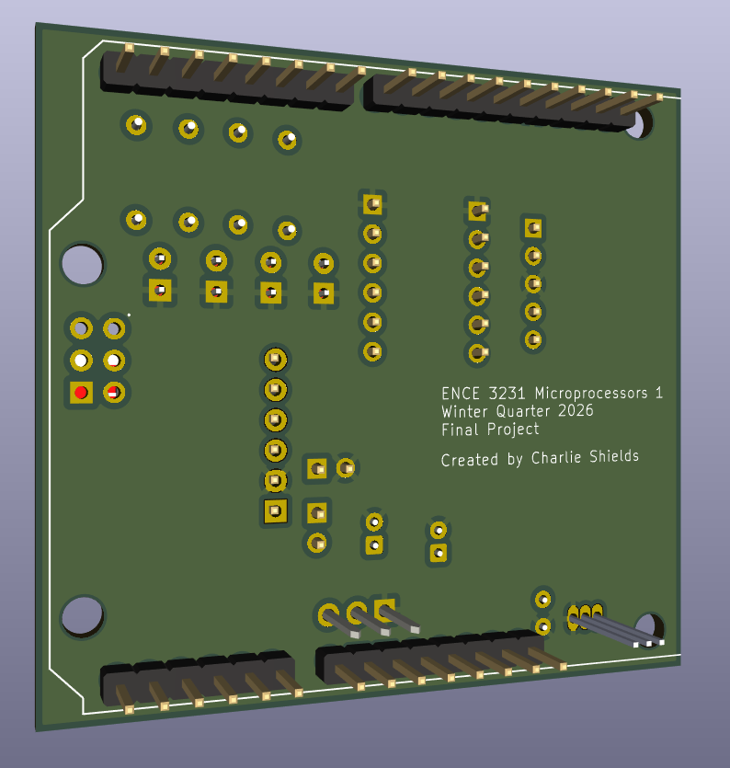

Slide 11
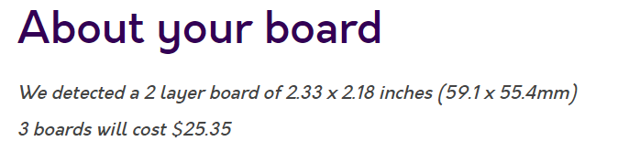
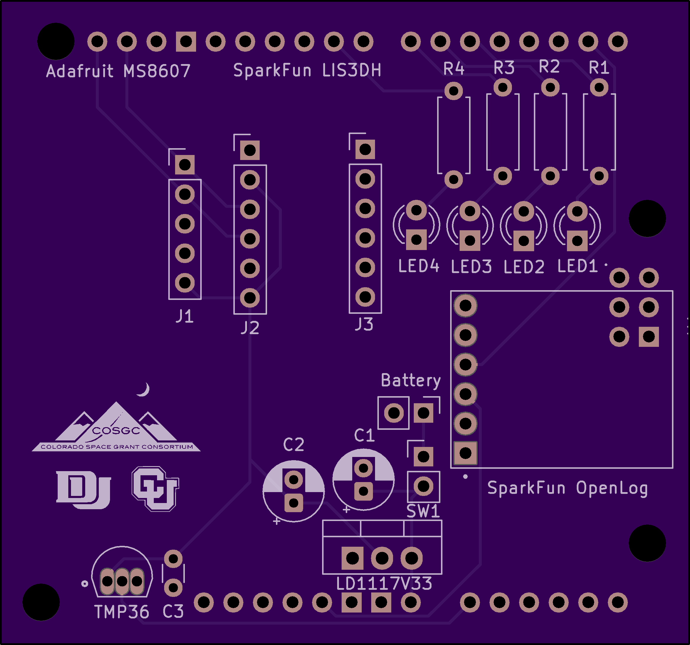
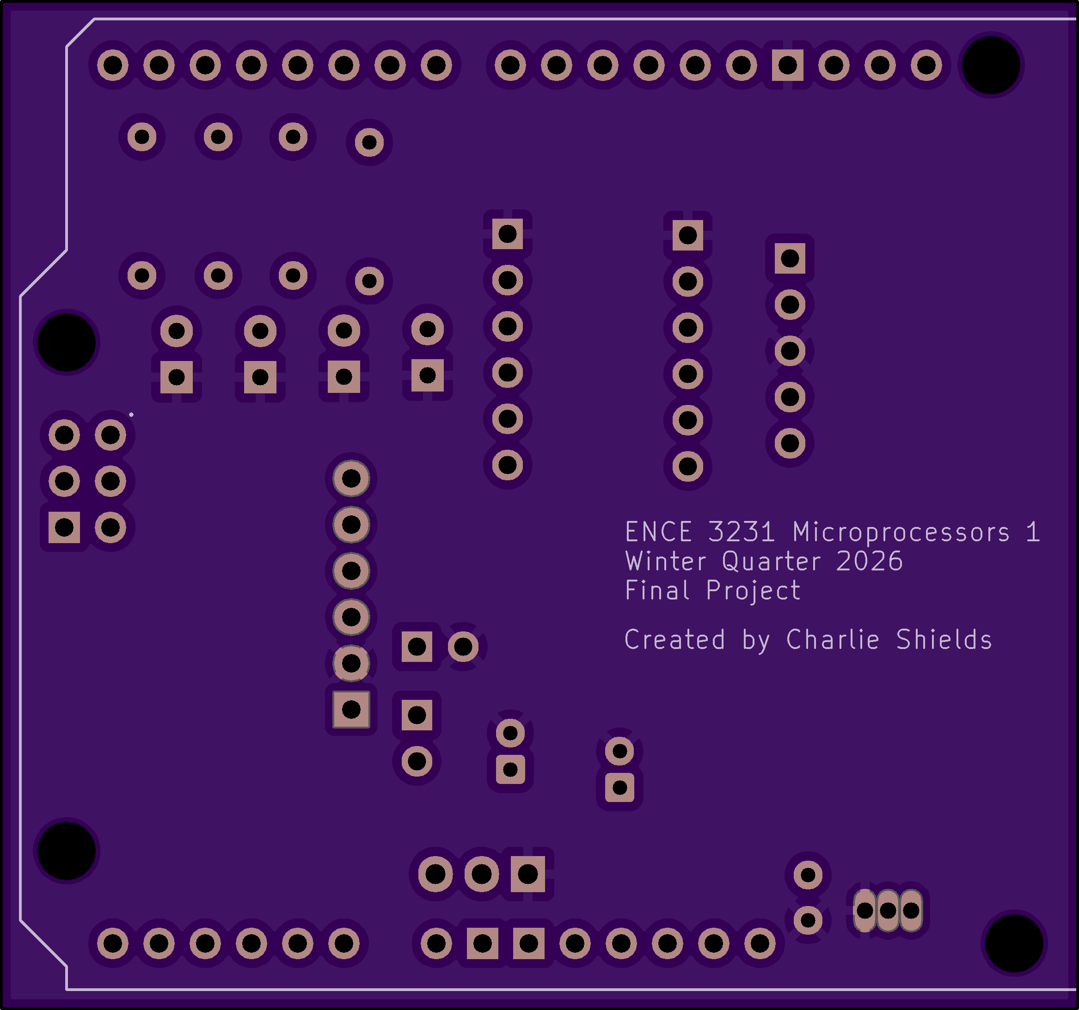
OSH-PARK

Slide 12
Phase 1 vs. Phase 2
Cost | Phase 1 | Phase 2
Sensors | HIH-4030 ($53k!), ASDX ($35+), ADXL335 ($22.27) | MS8607 ($14.95), LIS3DH ($7.75)
Data logger | $17.50 | $17.50
Total | ~$70+ (with unobtainable parts) | ~$40.20 (all available)
Weight | Phase 1 | Phase 2
Electronics + PCB | ~108-113 g | ~82 g
Battery | ~45 g | ~45 g
Enclosure | ~30-50 g | ~30-50 g
Total | ~138-163 g | ~112-127 g
Power | Phase 1 | Phase 2 (lin reg) | Phase 2 (buck)
Useful load | ~308 mW | ~275 mW | ~275 mW
Regulator loss | ~184 mW (hidden) | ~570 mW | ~50 mW
Total from battery | ~492 mW | ~845 mW | ~325 mW
Est. battery life | ~3 hrs | ~1.5 hrs | ~4-5 hrs

Slide 13
Improvements
I2C Bus (Heavy)
Linear Voltage Regulator (5.7v drop)

